Slide 1

Dr. Palmer, Regional Anesthesiologist
Day in the life :
Dr. Palmer works in the pre-operation suite (pre-op), where the environment is pseudo-sterile. Multiple patients can be in pre-op at any one time, giving it an “assembly line” feel.
Goals:
Ensure patient safety and comfort while balancing throughput and efficiency in a time-dependent environment
Reduce the amount of medication given with the use of ultrasound
About :
Regional Anesthesiologist
Technology savvy, keeps informed on the latest trends
Attends to inpatient & outpatient
On the job ultrasound training
Interested in teaching & mentoring
Common Tasks :
Task attributes :
Central line placements
Nerve blocks
Vascular access
Exam time 5 -10 minutes
2D and Color to locate structures
U/S for catheter/needle placements
Enters patient information or annotations when saving/billing an exam
Needs :
Excellent image quality
Quick boot-up time
Good needle visualization
Ability to see clinical monitor over patient bed
Self complete sterile procedures
Easy to instruct an assistant
Simple feature set (control options)
Easy to clean
Small footprint
2 probes (linear, curved)
Feature use
Billing
US
L
H
L
H
EU
L
H
L
H
AU
L
H
L
H
Notes:
PRIMARY PERSONA

Slide 2
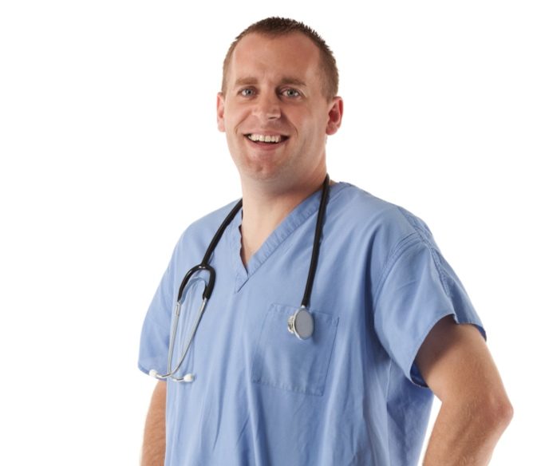
Dr. Moore, Emergency Medicine
Day in the life :
Dr. Moore works a rotating shift of 3-4 days each with multiple doctors on each shift. When a patient arrives at the hospital, Dr. Moore with a group of nurses and technicians evaluate the patient’s condition.
Goals:
Important that his department be as good, if not better than other hospitals in emergency care
Complete FAST exams in record time
Emergency Medicine physician
Participates in competitive sports and volunteer activities
Works in inpatient setting
Has a Registry in Diagnostic U/S
Interested in teaching and mentoring
Common Tasks :
Task attributes :
FAST exams
Abdominal Aortic Aneurysm
Early OB
Exam time 5-10 mins
Uses 2D, Doppler and Color to take basic measurements
Rarely enters patient information or annotations
Does NOT routinely print or save images/clips
Uses ultrasound when making life or death decisions
Excellent image quality
Quick boot-up time
Machine must be tough
Small footprint
Easy to use
Easily cleaned
2 – 3 probes (linear, curved, phased)
Learning videos and guided protocols to support resident training
Cardiac Calcs
Billing
US
L
H
L
H
EU
L
H
L
H
AU
L
H
L
H

Slide 3
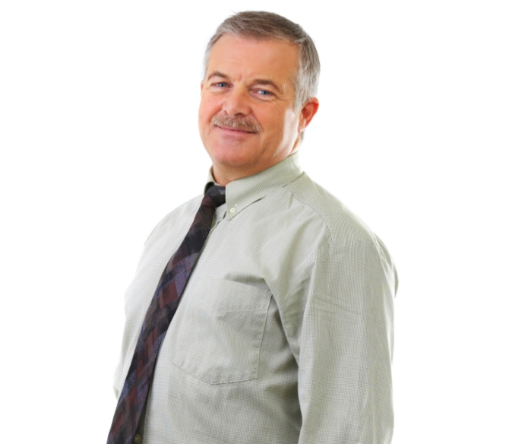
Dr. Rinoir, Critical Care
Day in the life :
Dr. Renoir visits each patient at the bedside to evaluate their state of care. He does all of his ultrasound exams during morning rounds.
Goals:
Wants to promote the use of ultrasound as Standard of Care
Use a machine that can easily perform vascular access, FAST and lung exams with access to a more complex feature set when needed
Common Tasks :
Task attributes :
Pulmonologist w/ Critical Care specialty
Participates in winter sports
Works in inpatient setting
On the job ultrasound training
Interested in teaching and mentoring
Limited Cardiac exams (2-3 measurements)
Central line placements (procedures)
Check for Pleural fluid
Exam time 5-10 mins
Uses 2D, Doppler and Color to take basic measurements
Uses ultrasound to check status of patient and guide catheter placements
Only enters patient information or annotations when saving/billing an exam
Saves images/clips to the EMR or via DICOM
Excellent image quality
Quick boot-up time
Machine must be tough
Small footprint
Easy to use
Easily cleaned
2 – 3 probes (linear, curved, phased)
USB connectivity required
Ability to easily show U/S images to his students and/or patients
Cardiac Calcs
Billing
US
L
H
L
H
EU
L
H
L
H
AU
L
H
L
H

